Slide 1
Solar power
Maths and the environment

Slide 2
How our teaching resources are designed for the classroom

Slide 3
I can consider the implications of installing solar panels.

Slide 4
A variable is a quantity that can take on a range of values.
A formula is a rule linking sets of physical variables in context.
An average is a single number expressing the central or typical value in a set of data: the mode; the median; and the mean.

Slide 5

Solar power
Calculating the cost of electricity
Calculating possible savings with solar panels
Calculating the cost of installing solar panels

Slide 6
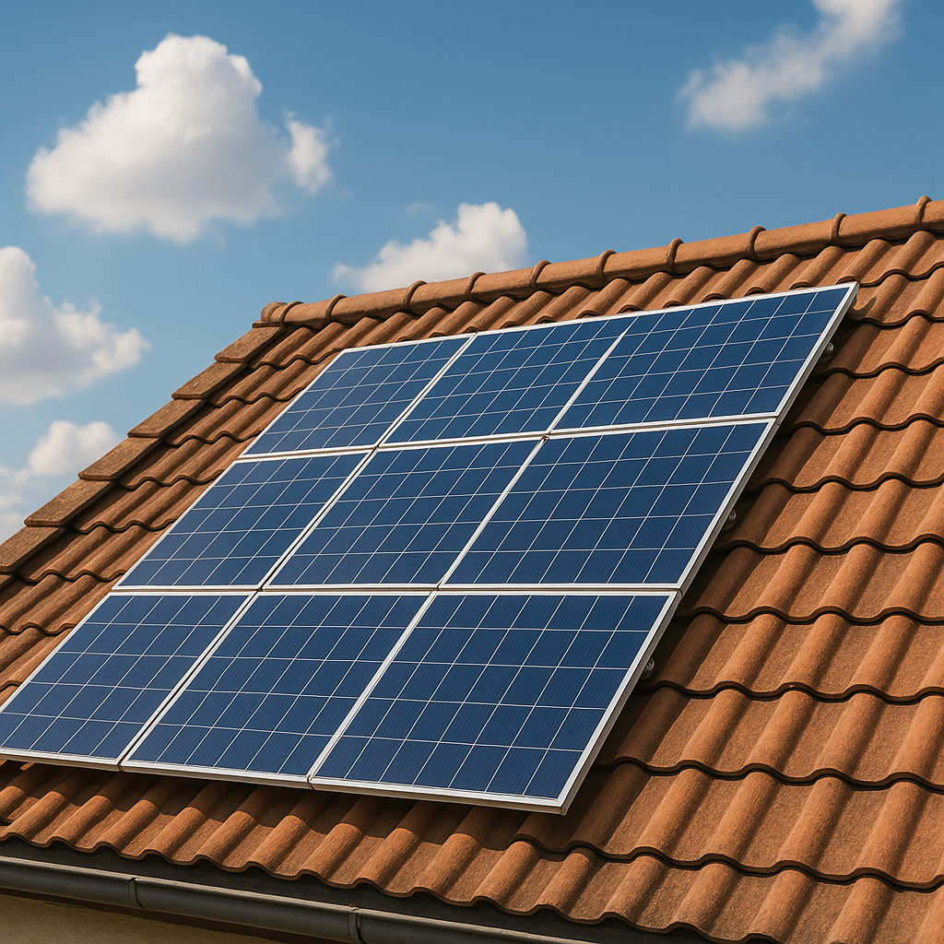
Calculating the cost of electricity
The occupants of a home pay lots of different bills. One of these is for their supply of electricity.
What factors could affect the amount of money that a household spends on electricity?
Amount of electricity used:
size of the house
the number of occupants
number of appliances
how much time people spend at home (e.g. working)
Cost of electricity:
cost per unit of electricity used
any additional fees
any discounts based on payment method (e.g. direct debit)

Slide 7
Calculating the cost of electricity
The cost of electricity varies over time.
The cost of equipment, materials and labour also vary over time.
The performance and efficiencies of equipment may also improve over time, due to advances in technology.
All figures used in this lesson are approximations based on averages from the UK in 2024.

Slide 8
Calculating the cost of electricity
A typical 1-bedroom house consumes an average of 4.9 kWh of electricity per day.
How much electricity would this be per month?
Alternatively, approximations could be made based on 30.5 days per month.
For a month with 30 days: 4.9 × 30 = 147 kWh
For a month with 31 days: 4.9 × 31 = 151.9 kWh
How much electricity would this be per year?
For a year with 365 days: 4.9 × 365 = 1788.5 kWh
≈ 1800 kWh per year

Slide 9
Calculating the cost of electricity
In 2024, the average cost of electricity could be calculated as:
24.5 p per kWh consumed + 60 p daily standing charge
This part of the cost varies depending on how much electricity is consumed.
This part of the cost is constant. It is paid every day, regardless of how much electricity is consumed.

Slide 10
Calculating the cost of electricity
In 2024, the average cost of electricity could be calculated as:
24.5 p per kWh consumed + 60 p daily standing charge
A typical 1-bedroom house consumes an average of 4.9 kWh of electricity per day.
How much would this cost per day?
24.5 × 4.9 + 60 = 180.05 p
≈ £1.80 per day

Slide 11
Calculating the cost of electricity
In 2024, the average cost of electricity could be calculated as:
24.5 p per kWh consumed + 60 p daily standing charge
A typical 1-bedroom house consumes an average of 4.9 kWh of electricity per day.
How much would this cost per month (based on 30.5 days)?
(24.5 × 4.9 + 60) × 30.5 = 5491.525 p
≈ £54.92 per month

Slide 12
Calculating the cost of electricity
In 2024, the average cost of electricity could be calculated as:
24.5 p per kWh consumed + 60 p daily standing charge
A typical 1-bedroom house consumes an average of 4.9 kWh of electricity per day.
How much would this cost per year?
(24.5 × 4.9 + 60) × 365 = 65 718.25 p
≈ £657.18 per year

Slide 13
Calculating the cost of electricity
A house with 2-3 bedrooms consumes an average of 7.9 kWh of electricity per day.
How much electricity would this be per year? Give your answer rounded to 2 significant figures.
7.9 × 365 = 2883.5 kWh
≈ 2900 kWh per year

Slide 14
Calculating the cost of electricity
A house with 2-3 bedrooms consumes an average of 7.9 kWh of electricity per day.
In 2024, the average cost of electricity was:
24.5 p per kWh consumed + 60 p daily standing charge
How much would this cost per day?
24.5 × 7.9 + 60 = 253.55 p
≈ £2.54 per day

Slide 15
Calculating the cost of electricity
A house with 2-3 bedrooms consumes an average of 7.9 kWh of electricity per day.
In 2024, the average cost of electricity was:
24.5 p per kWh consumed + 60 p daily standing charge
How much would this cost per year?
(24.5 × 7.9 + 60) × 365 = 92 545.75 p
≈ £925.46 per year

Slide 16
Calculating the cost of electricity
1) A house with 4 or more bedrooms consumes an average of 11.8 kWh of electricity per day. In 2024, the average cost of electricity in the UK could be calculated as:
24.5 p per kWh consumed + 60 p daily standing charge
a) How much electricity would this house consume per year?
b) What would be the daily cost of electricity for this house?
c) What would be the monthly cost of electricity for this house (based on 30.5 days)?
d) What would be the annual cost of electricity for this house?

Slide 17
Calculating the cost of electricity
1) A house with 4 or more bedrooms consumes an average of 11.8 kWh of electricity per day. In 2024, the average cost of electricity in the UK could be calculated as:
24.5 p per kWh consumed + 60 p daily standing charge
a) How much electricity would this house consume per year?
11.8 × 365 = 4307 kWh
b) What would be the daily cost of electricity for this house?
24.5 × 11.8 + 60 = 349.1 p = £3.49
c) What would be the monthly cost of electricity for this house (based on 30.5 days)?
(24.5 × 11.8 + 60) × 30.5 = 10 647.55 p ≈ £106.48
d) What would be the annual cost of electricity for this house?
(24.5 × 11.8 + 60) × 365 = 127 421.5 p ≈ £1274.22

Slide 18
Solar power
Calculating the cost of electricity
Calculating possible savings with solar panels
Calculating the cost of installing solar panels

Slide 19
Calculating possible savings with solar panels
Solar panels are a source of renewable energy. They capture energy from the Sun and convert it into electricity.
People can install solar panels on a roof to generate electricity.
This electricity can be used by occupants to reduce the amount of electricity that they require from an energy supplier company.
The size of a property determines how many solar panels can be installed.

Slide 20
Calculating possible savings with solar panels
What factors could affect the amount of electricity that is produced by a set of solar panels on a property?
Examples include:
the number of panels installed;
the amount of sunlight;
the location of the property (e.g. Scotland vs France);
the direction that the panels face (e.g. south-facing vs north-facing);
nearby obstructions that cast shade (e.g. taller buildings or trees);
how efficiently the panels convert light into electricity.

Slide 21
Calculating possible savings with solar panels
Solar panels do not produce a constant amount of electricity throughout a year, or even throughout a day.
They produce the most amount of electricity during the middle of the day (when there is more peak sunlight).
They also produce more electricity in the summer than the winter.
Calculating the exact amount of electricity that a solar panel will produce per day can be difficult, as conditions vary.
We can estimate the average amount of electricity that a solar panel could produce based on the average amount of peak sunlight it captures per day, throughout the year.

Slide 22
Calculating possible savings with solar panels
The amount of electricity generated by a solar panel could be calculated using the formula below.
E = PH
where:
E = amount of electricity produced (kWh)
P = power rating of panel (kW)
H = amount of peak sunlight (h)

Slide 23


Calculating possible savings with solar panels
A house in the north of England has solar panels.
Each panel has a power rating of 350 watts.
On average, it gets 3 hours of peak sunlight per day.
How much electricity does each panel produce per day, on average?
The amount of electricity will be an average because the calculation is based on the average amount of sunlight.
Jacob

Slide 24
Calculating possible savings with solar panels
A house in the north of England has solar panels.
Each panel has a power rating of 350 watts.
On average, it gets 3 hours of peak sunlight per day.
How much electricity does each panel produce per day, on average?
The actual amount of electricity it produces will fluctuate throughout the year, as the amount of sunlight varies.
Jacob

Slide 25
Calculating possible savings with solar panels
A house in the north of England has solar panels.
Each panel has a power rating of 350 watts.
On average, it gets 3 hours of peak sunlight per day.
How much electricity does each panel produce per day, on average?
E = PH
350 watts = 0.35 kilowatts
E = electricity produced (kWh)
Electricity generated:
0.35 × 3 = 1.05 kWh per day
P = power rating of panel (kW)
H = amount of peak sunlight (h)

Slide 26

Calculating possible savings with solar panels
What is 320 watts in kilowatts?
0.032 kW
0.32 kW
3.2 kW
32 kW

Slide 27
Calculating possible savings with solar panels
A house in the south of England has solar panels.
Each panel has a power rating of 320 watts.
On average, it gets 4.2 hours of peak sunlight per day.
How much electricity does each panel produce per day, on average?
E = PH
320 W = 0.32 kW
E = electricity produced (kWh)
Electricity generated:
0.32 × 4.2 = 1.344 kWh per day
P = power rating of panel (kW)
H = amount of peak sunlight (h)

Slide 28
Calculating possible savings with solar panels
A house in the south of England has solar panels.
In ideal conditions, each solar panel would generate 1.344 kWh of electricity per day, on average.
However, performance is reduced by shade and direction. So, it produces 20% less electricity than it would in ideal conditions.
How much electricity does the panel produce? Give your answer accurate to 3 significant figures.
A 20% decrease leaves 80% remaining.
0.8 × 1.344 = 1.0752
≈ 1.08 kWh

Slide 29
Calculating possible savings with solar panels
A house has 12 solar panels in total.
Each panel produces 1.05 kWh of electricity per day, on average.
The house typically consumes 14.8 kWh of electricity per day.
How much remaining electricity, per day, would the occupants need to consume from their electricity supplier company?
Electricity generated by solar panels: 12 × 1.05 = 12.6 kWh per day
Remaining electricity required: 14.8 – 12.6 = 2.2 kWh per day

Slide 30
Calculating possible savings with solar panels
The cost of electricity can be calculated as:
24.5 p per kWh consumed + 60 p daily standing charge
The occupants of a house need to consume 2.2 kWh of electricity per day from their energy supplier company.
Calculate the annual cost of electricity for this house.
Per day: 24.5 × 2.2 + 60 = 113.9 p
Per year: 113.9 × 365 = 41 573.5 p
≈ £415.74

Slide 31
Calculating possible savings with solar panels
If the house sources all of its electricity from its energy supplier company, the total cost would be £1542.49 per annum.
With the solar panels, the cost is only £415.74 per annum.
How much money do the occupants save each year?
1542.49 – 415.74 = £1126.75

Slide 32
Calculating possible savings with solar panels
A house in the south of England has 6 solar panels.
Each panel produces 1.08 kWh of electricity per day, on average.
The house typically consumes 9.8 kWh of electricity per day.
How much remaining electricity, per day, would the occupants need to consume from their electricity supplier company?
Electricity generated by solar panels: 6 × 1.08 = 6.48 kWh per day
Remaining electricity required: 9.8 – 6.48 = 3.32 kWh per day

Slide 33
Calculating possible savings with solar panels
The cost of electricity can be calculated as:
24.5 p per kWh consumed + 60 p daily standing charge
The house only needs 3.32 kWh of electricity from its energy supplier company.
Calculate the annual cost of electricity for this house.
Per day: 24.5 × 3.32 + 60 = 141.34 p
Per year: 141.34 × 365 = 51 589.1 p
≈ £515.89

Slide 34
Calculating possible savings with solar panels
If the house sources all of its electricity from its energy supplier company, the total cost would be £1095.37 per annum.
With the solar panels, the cost is only £515.89 per annum.
How much money do the occupants save each year?
1095.37 – 515.89 = £579.48

Slide 35
Calculating possible savings with solar panels
1) A house consumes an average of 11.8 kWh of electricity per day. The cost of obtaining electricity from a supplier company can be calculated using the following formula:
cost = 24.5 p per kWh consumed + 60 p daily standing charge
The owners install 8 solar panels, each with a power rating of 380 watts. The panels get 4.5 hours of peak sunlight per day, on average. The performance of the panels is reduced by 25% due to factors like shade.
How much money do the occupants save each year on their electricity bills by having solar panels?
E = PH
E = electricity produced (kWh)
P = power rating of panel (kW)
H = amount of peak sunlight (h)

Slide 36
Calculating possible savings with solar panels
1) A house consumes an average of 11.8 kWh of electricity per day. The cost of obtaining electricity from a supplier company can be calculated using the following formula:
cost = 24.5 p per kWh consumed + 60 p daily standing charge
The owners install 8 solar panels, each with a power rating of 380 watts. The panels get 4.5 hours of peak sunlight per day, on average. The performance of the panels is reduced by 25% due to factors like shade.
How much money do the occupants save each year on their electricity bills by having solar panels?
E = PH
E = electricity produced (kWh)
P = power rating of panel (kW)
H = amount of peak sunlight (h)

Slide 37
Calculating possible savings with solar panels
1) Cost = 24.5 p per kWh consumed + 60 p daily standing charge
Use 11.8 kWh per day
8 solar panels
380 W 4.5 h peak sunlight 25% reduction
E = PH
Cost if all electricity was provided by their energy supplier company: (24.5 × 11.8 + 60) × 365 = 127 421.5 p
E = electricity produced (kWh)
P = power rating of panel (kW)
H = amount of peak sunlight (h)
Electricity produced by 8 solar panels per day: 0.38 × 4.5 × 0.75 × 8 = 10.26 kWh
Remaining electricity required: 11.8 – 10.26 = 1.54 kWh
Cost of electricity with solar panels: (24.5 × 1.54 + 60) × 365 = 35 671.45 p
Money saved per year: 127421.5 – 35671.45 = 91 750.05 p ≈£917.50

Slide 38
Solar power
Calculating the cost of electricity
Calculating possible savings with solar panels
Calculating the cost of installing solar panels

Slide 39
Calculating the cost of installing solar panels
Solar panels can help reduce electricity bills. However, they require an initial investment of money to buy and install.
What factors could be involved in the cost of installing solar panels?
Examples include:
price of each panel;
price of storage batteries;
any additional equipment that is required to connect the solar panels to the house’s electricity supply (e.g. inverter, wiring, etc);
labour costs for the panels to be installed.
While there is an upfront cost, solar panels reduce the cost of electricity bills. Eventually, the amount saved will be more than the upfront cost.

Slide 40
Calculating the cost of installing solar panels
The owners of a house are considering investing in solar panels.
They plan to buy a system with 12 panels.
The costs involved with buying and installing the panels are below.
Price per panel: £350 Storage battery: £5000 Other required electrical equipment: £1500 Labour costs: £1200
What will be the total upfront cost for buying and installing the solar panels?
12 × 350 + 5000 + 1500 + 1200 = £11 900

Slide 41
Calculating the cost of installing solar panels
The upfront cost for buying and installing the solar panels is £11 900.
After they are install, the house owner saves £1126.75 per year on their electricity bills.
How many years will it take for their annual savings to sum to more than the upfront cost of buying and installing the solar panels?
11 900 ÷ 1126.75 = 10.561…
≈ 11 years

Slide 42
Calculating the cost of installing solar panels
The owners of a house are considering investing in solar panels.
They plan to buy a system with 6 panels.
The costs involved with buying and installing the panels are below.
Price per panel: £440 Storage battery: £6000 Other required electrical equipment: £1200 Labour costs: £1100
What will be the total upfront cost for buying and installing the solar panels?
6 × 440 + 6000 + 1200 + 1100 = £10 940

Slide 43
Calculating the cost of installing solar panels
The upfront cost for buying and installing the solar panels is £10 940.
After they are install, the house owner saves £917.51 per year on their electricity bills.
How many years will it take for their annual savings to sum to more than the upfront cost of buying and installing the solar panels?
10 940 ÷ 917.51 = 11.923…
≈ 12 years

Slide 44
Calculating the cost of installing solar panels
1) The occupants of a house buy 8 solar panels.
The costs involved with buying and installing the panels are shown below.
Price per panel: £200 Storage battery: £4000 Other required electrical equipment: £1700 Labour costs: £1500
a) How much will it cost in total to buy and install the solar panels?
b) Their annual electricity bill without solar panels was £1275. Their annual electricity bill with solar panels is £350. How much money do they save per year by having solar panels?
c) How many years will it take for their annual savings to sum to more than the upfront cost of buying and installing the solar panels?

Slide 45
Calculating the cost of installing solar panels
2) The occupants of a house are considering investing in solar panels. Previously, they obtained all their electricity from their energy supplier company, with an annual bill of £1400. The solar panels cost £8400 to buy and install. Once the panels are installed, their annual electricity bill is estimated to be £300.
a) Complete the table below to show the total money spent after each year.
number of years | 0 | 1 | 2 | 3 | 4 | 5 | 6 | 7 | 8 | 9 | 10
total cost without solar (£ thousands) | 0 | 1.4
total cost with solar (£ thousands) | 8.4 | 8.7

Slide 46

Calculating the cost of installing solar panels
12
b) Use your answer from part (a) to plot a graph showing total money spent after each year without solar panels.
11
10
9
8
c) Use your answer from part (a) to plot a graph showing total money spent after each year with solar panels.
7
total money spent (£ thousands)
6
5
4
d) How many years will it take for the solar panels to pay for themselves?
3
2
1
0
0
1
2
3
4
5
6
7
8
9
10
number of years

Slide 47
Calculating the cost of installing solar panels
1) The occupants of a house buy 8 solar panels. The costs involved with buying and installing the panels are shown below.
Price per panel: £200 Storage battery: £4000 Other required electrical equipment: £1700 Labour costs: £1500
£8800
a) How much will it cost in total to buy and install the solar panels?
b) Their annual electricity bill without solar panels was £1275.
Their annual electricity bill with solar panels is £350.
How much money do they save per year by having solar panels?
£925
8800 ÷ 925 = 9.513…
c) How many years will it take for their annual savings
to sum to more than the upfront cost of buying and
installing the solar panels?
After 10 years

Slide 48
Calculating the cost of installing solar panels
2) The occupants of a house are considering investing in solar panels. Previously, they obtained all their electricity from their energy supplier company, with an annual bill of £1400. The solar panels cost £8400 to buy and install. Once the panels are installed, their annual electricity bill is estimated to be £300.
a) Complete the table below to show the total money spent after each year.
number of years | 0 | 1 | 2 | 3 | 4 | 5 | 6 | 7 | 8 | 9 | 10
total cost without solar (£ thousands) | 0 | 1.4
total cost with solar (£ thousands) | 8.4 | 8.7
2.8
4.2
5.6
7
8.4
9.8
11.2
12.6
14
9
9.3
9.6
9.9
10.2
10.5
10.8
11.1
11.4

Slide 49
Calculating the cost of installing solar panels
12
b) Use your answer from part (a) to plot a graph showing total money spent after each year without solar panels.
11
10
9
without solar panels
8
c) Use your answer from part (a) to plot a graph showing total money spent after each year with solar panels.
7
total money spent (£ thousands)
6
5
with solar panels
4
d) How many years will it take for the solar panels to pay for themselves?
3
2
1
7.6 years or 8 years
0
0
1
2
3
4
5
6
7
8
9
10
number of years

Slide 50
Solar power
Solar panels can reduce the cost of electricity bills but they require an upfront cost to buy and install.
The size of the property determines how many solar panels can be installed.
The amount of energy generated depends on a variety of factors (e.g. their location, direction, amount of shade, etc).
It is possible to calculate when solar panels have paid for themselves.

Slide 51

© Oak National Academy 2024.
Produced in partnership with Mathematics in Education and Industry.
Licensed on the Open Government Licence v3.0, except where otherwise stated. See Oak terms and conditions.

